Slide 1

Inferring Locations in Twitter
SANDEEP MUPPIREDDY
SRIKANTH MATURU
SIDDHARTHA GANDHA
DANNEN GU

Slide 2
Overview
Background & Motivation
Applications & Basic Idea
Data collection & Filtering
Related approaches
Total Variation Minimization
Results & Evaluation
Future Work
Summary

Slide 3
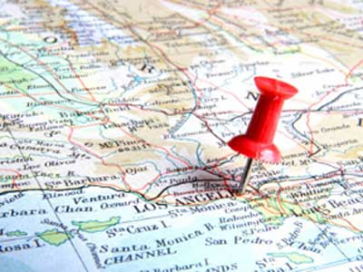
Background
Huge data available in internet
Data annotated with geographic location is very useful
Annotated data has applications in business, research and
election forecasting
Traditional data gathering and public opinion collection
like online surveys, exit polls and door to door feedback
is time consuming

Slide 4
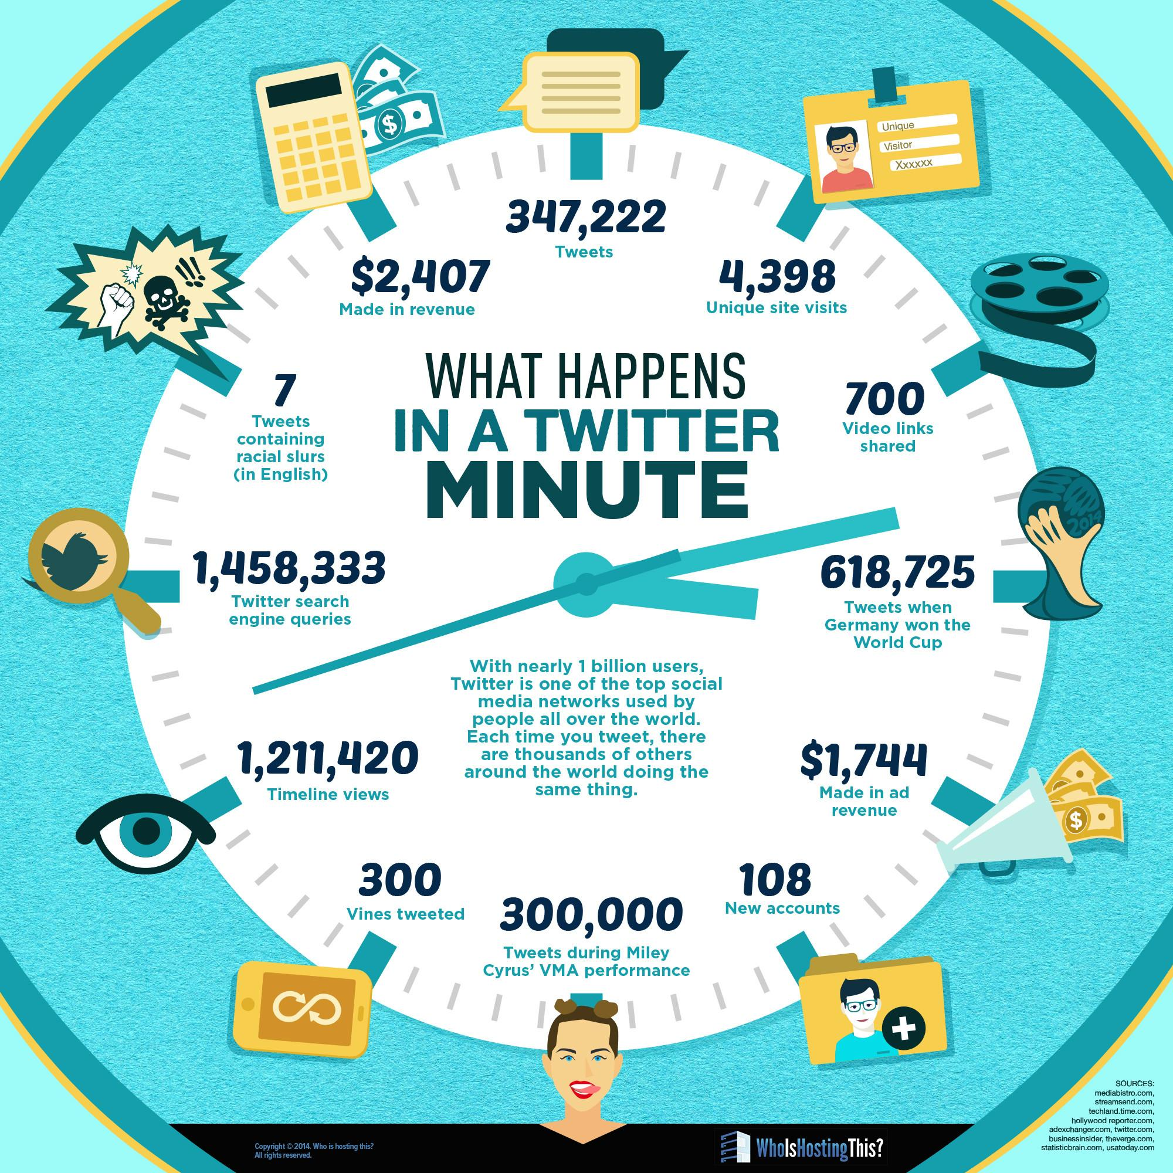
Twitter
Social media provides real time public opinions and product feedbacks
Twitter has 320 million monthly active users
500 million tweets per day on average
Finding locations of tweets has immense advantages

Slide 5
Motivation
Small percentage of twitter users share locations publicly
Location shared either through profile or annotating tweets by GPS location
Main objective is to geotag twitter users whose location is not shared publicly
Implement an algorithm that infers locations to twitter users

Slide 6
Applications
Disease trends
Election forecast
Product marketing
Disaster response
Social unrest

Slide 7
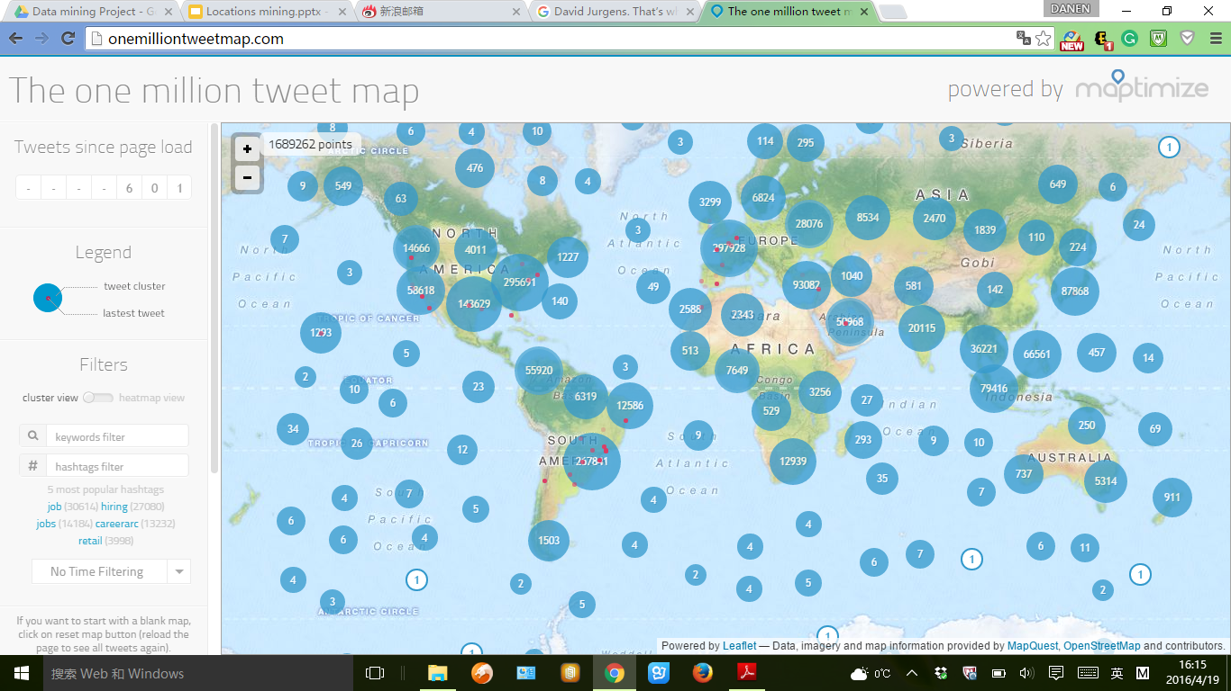




5
1
2
4
1
3

Slide 8
5
1
2
4
1
3

Slide 9


Slide 13
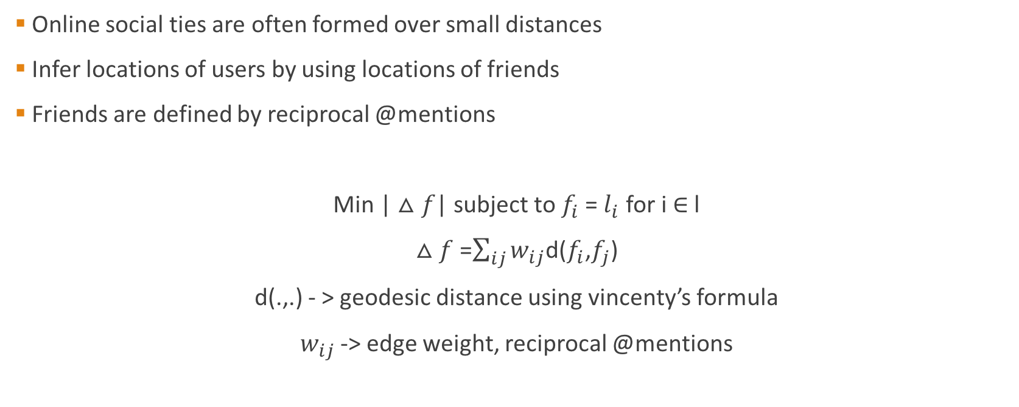
Basic Idea

Slide 14
Twitter Data
Twitter Data is public
Twitter API is used to access the real time tweet data.
Twitter API requests are rate limited
15 min rate window.
Twitter API resources used
Trends Resources
Tweets Resources
Friends/Followers Resources
User Timeline resources

Slide 15
Data Collection
Trends Resources
To obtain current trending popular hashtags/terms. Ex: #
Tweet Resources
Search real time tweets by hashtags, search terms
Friends/Followers Resources
Request list of friends and followers of a user
User Timeline Resources
List of users tweets from their timelines.

Slide 16
Ground Truth Locations
Twitter users can chose to publish their location on their profile or by geo-tagging their tweets.
Preprocessing is required for obtaining location from their profile
Place information is specified location field in the profile or could be specified in the description.
But, such data is sometimes noisy or irrelevant to user’s location
Pre-processing is needed to removed the noise

Slide 17
Ground Truth Locations
We filtered the profile information using stop words
Next, we determined the geographical coordinates by querying a popular worldwide geographical information database
GeoNames, is world wide geographical information database
API’s are available to query a location.

Slide 18
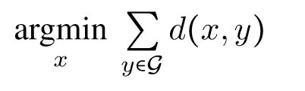
Ground Truth Locations
Twitter users may not be static. They always tend to move between places.
Such users tweets may give different locations at different times.
We determined ground truth locations in such case by calculating
L1-multivariate median of the locations

Slide 19
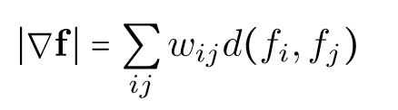

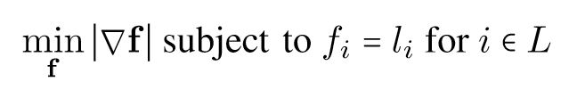
Total Variation Minimization
We use a network based approach to solve social media geotagging problem
Total Variation Minimization approach for estimating unknown locations of twitter users
Total Variation Minimization for geotagging problem can be defined as

Slide 20
Steps
We construct a Social Network with users as nodes.
Edges have weights
f is the desired function that encodes location estimate for users
f is fixed for users with known locations
For a given, f total variation is calculated by
We solve the equation for estimating unknown locations of twitter users.

Slide 21
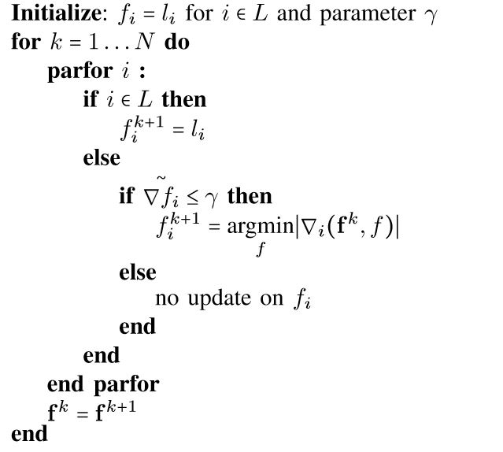
Algorithm

Slide 22
Data Collection
Tweets | 10 Million
Users | >50000
@mentions between two users atleast 1 | >100k
@mentions between two users atleast 3 | >50k
No of Users with known locations (from geotagged tweets or user’s profile) | 15%

Slide 23
Related Approach
Function f - estimates the location of each user
Users opt to make locations public using
Cell phone enabled GPS
Self reported profile information
For this set of users computation of f is straightforward
Users never opt to make location preferences
Our goal to assign a value of f to these users
What is the easiest thing your friends can do for you? To expose your locations!

Slide 24
GPS enabled users may tweet from different locations
Idea is to assign unique location to user from set of GPS tagged tweets
Computing median of locations they have tweeted from
Self reported profile locations
can be ambiguous
prefer if they have GPS known locations

Slide 25
Total Variation Minimization
Build Network - weighted sum over all geographic distances between connected users is as small as possible

